Slide 1



Uncovering Market Abuses with Data Insights
Presented by Srabana Baidya

Slide 2


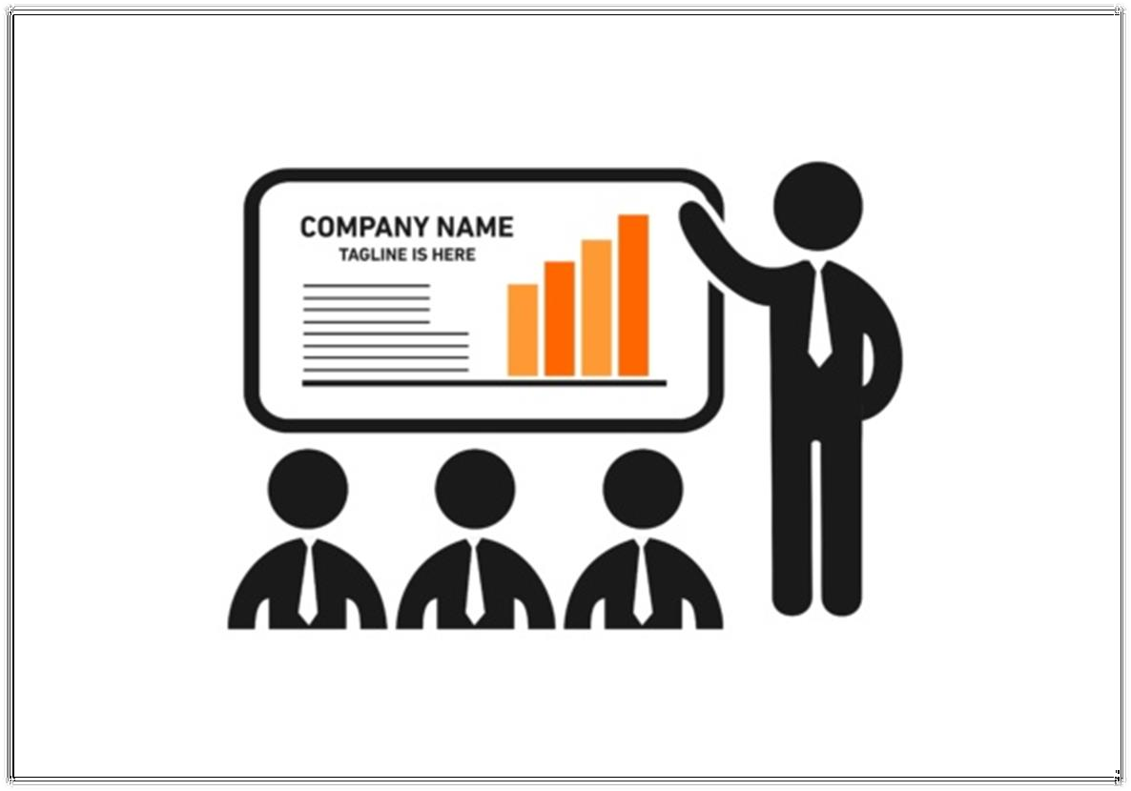
Table of Contents
Introduction to Market Abuse
Common Market Abuse Types
The Analyst's Challenge
The Datasets
Business Insights
Key Findings
Conclusion and Recommendations
Future Work

Slide 3

Types of Market Abuse
Insider Trading:Trading based on non-public, confidential information to gain an unfair
advantage,sometimes the ‘Insider’ can be someone who already works in that organization.
Wash Trading: Buying and selling the same stock simultaneously to create fake market activity.
Pump and Dump: Spreading false information to inflate a stock's price, then selling it at a profit, leaving others with losses.
Spoofing: Placing fake orders with the intent to cancel them before they are executed. The aim is to trick other traders into thinking there is higher demand or supply, thereby manipulating prices.
Front Running: Trading ahead of a large order to benefit from the price movement it creates.
Layering: Placing multiple fake orders to mislead the market about demand or supply.

Slide 4
The Analyst’s Challenge
Context: As a Data Analyst at EquiAnalytics Inc., you were tasked by the Risk Management team to investigate unusual trading patterns that could indicate market abuse. The goal was to identify any signs of manipulation in stock transactions and ensure regulatory compliance.
Challenge: You were provided with three datasets: surveillance_optimization, regulatory_enquiries, and market_manipulation_data. Your job was to clean and analyze these datasets to uncover hidden patterns of abuse and provide actionable insights.
Approach: Using SQL, you habe to systematically clean the data, perform aggregations and calculations to detect anomalies, and analyze user behaviors to pinpoint potential manipulators,risks and areas to focus.

Slide 5
The Datasets
Dataset 1: Surveillance Optimization
Dataset 1:Regulatory Enquiries
Dataset 3:Market Manipulation Data
Description: Contains transactional data including transaction IDs, stock IDs, transaction prices, volumes, and dates.
Description:Logs of regulatory enquiries made by users, capturing details such as enquiry date, user ID, and enquiry price.
Description: Contains detailed records of trading activities that may be indicative of market manipulation
Key Fields: Transaction_ID, Stock, Transaction_Price, Volume, Transaction_Date
Key Fields: Enquiry_ID, User_ID, Enquiry_Date, Enquiry_Price
Key Fields:Transaction_ID, User_ID,Stock,Order_Price, Order_Volume,Date_of_Man ipulation, Order_Type

Slide 6


Business Insights

Slide 7
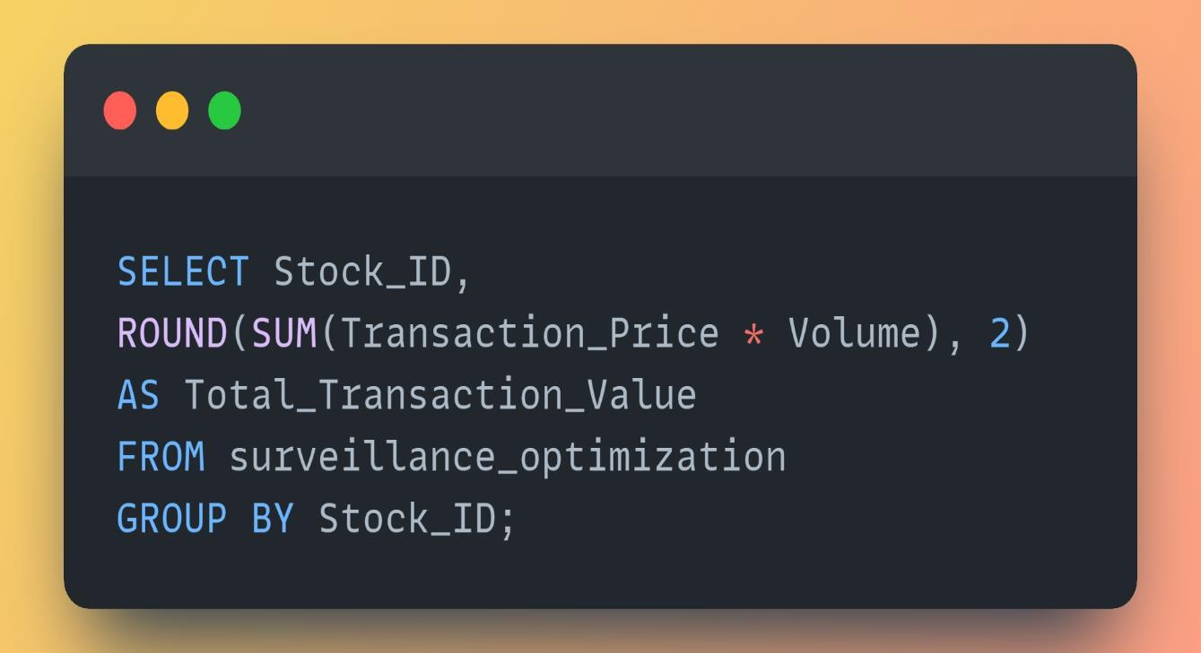

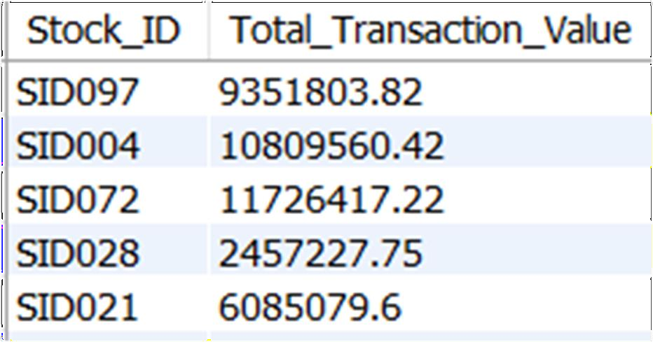
Business Insights-1
F i n d t h e T o t al T r a n s a ct I o n V al ue f o r E a c h S t o c k in t h e s u r v e i la n c e D a t a.

Slide 8
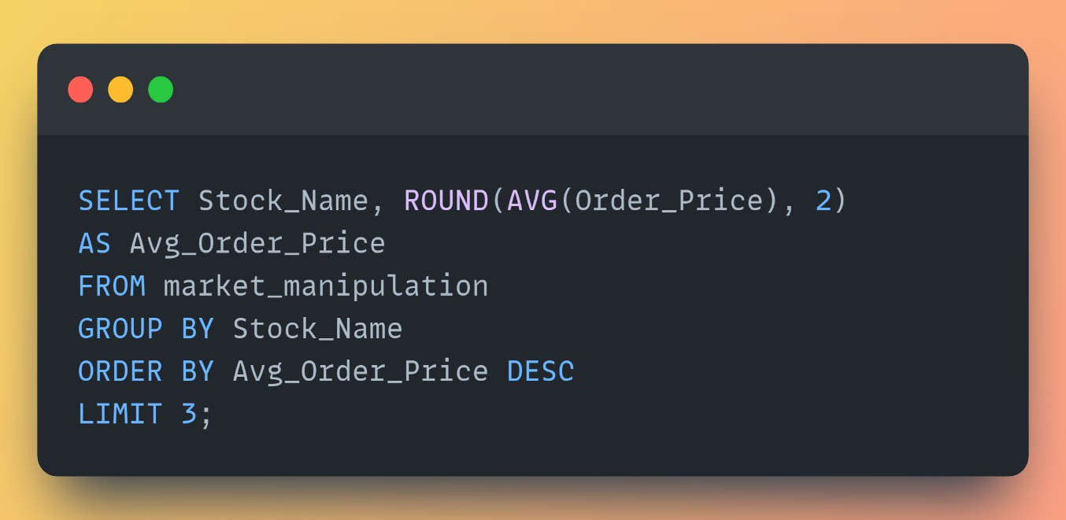

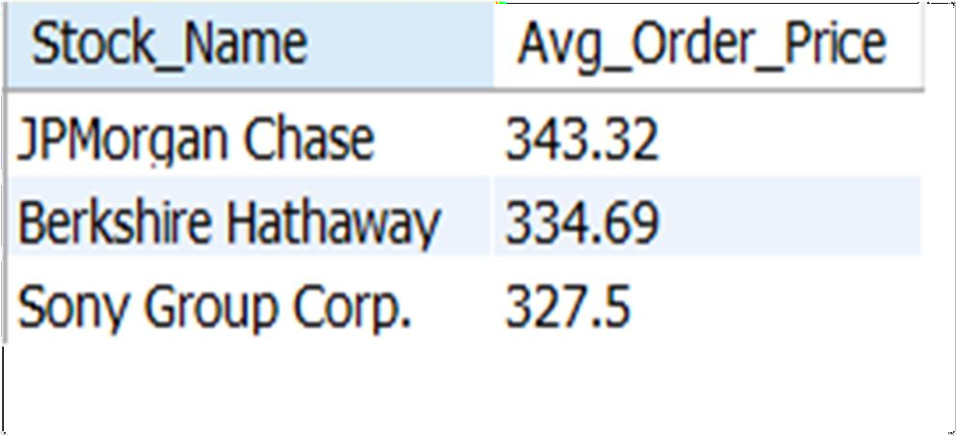
Buies Question-2
Identify the top three manipulated Stocks with the Highest Average Order Price.

Slide 9
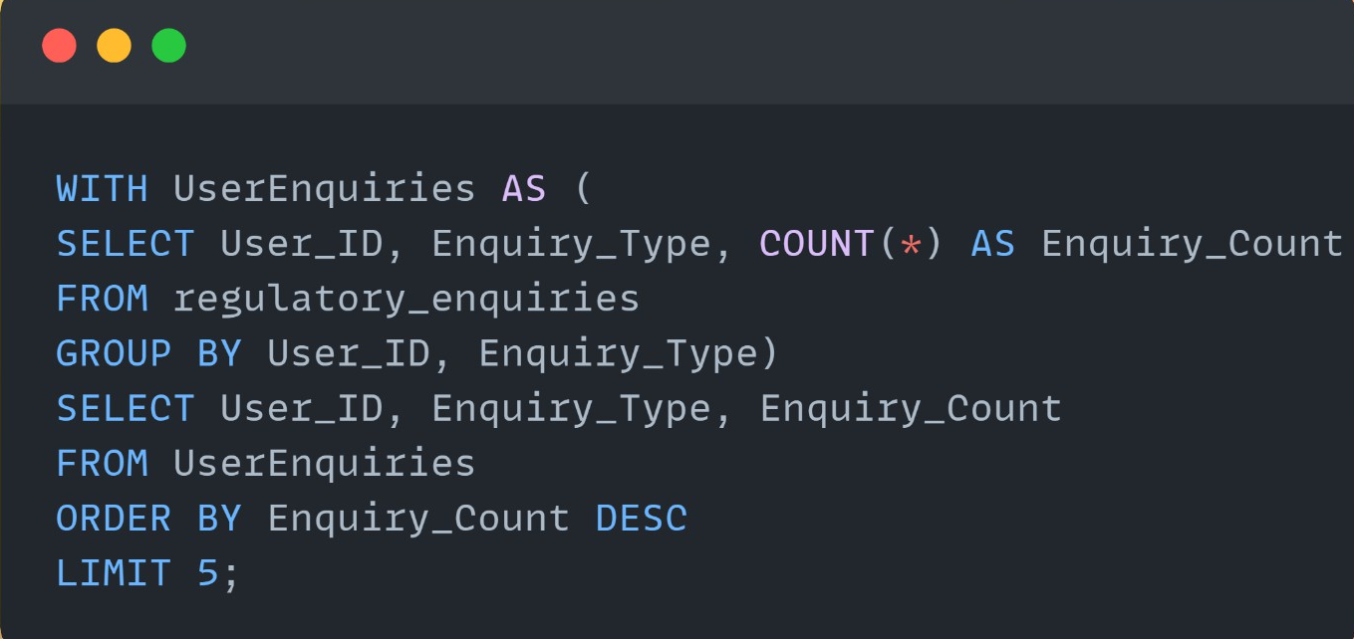

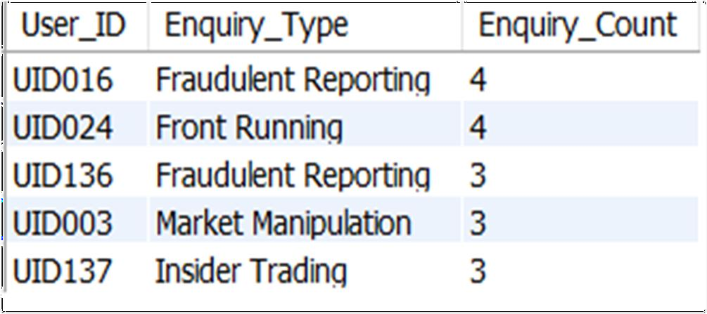
Business Question-3
Find the Top five Enquiry_Type and the users who requested it.

Slide 10
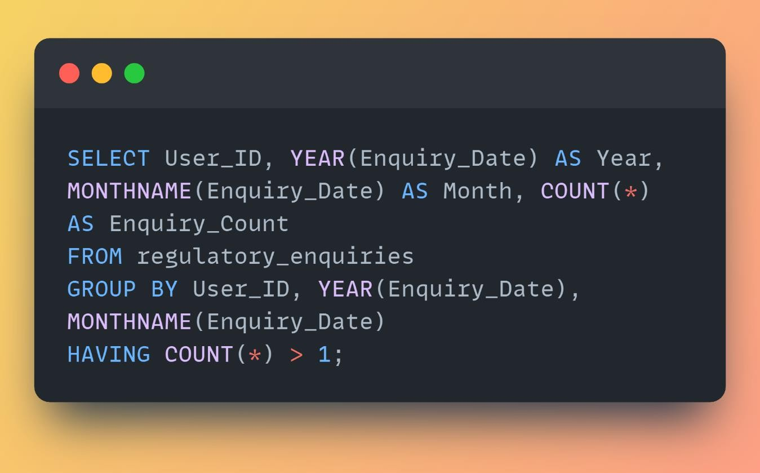

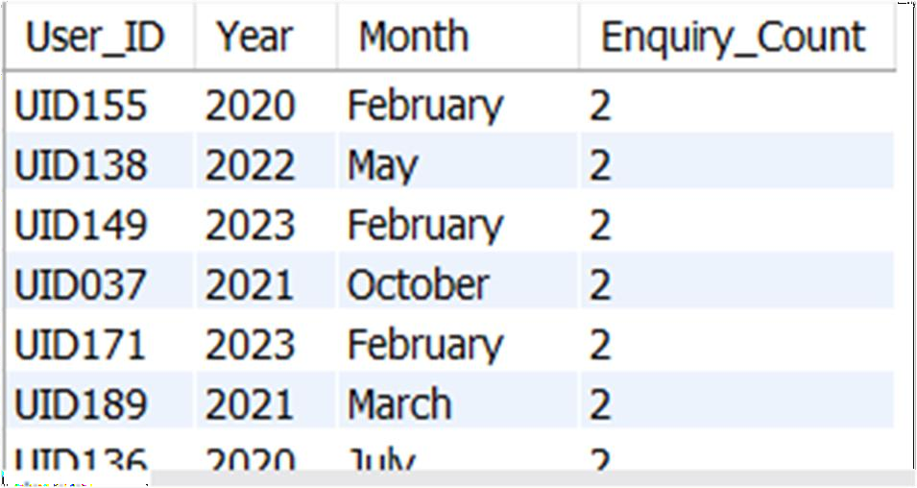
Find Users Who Made More Than one Regulatory Enquiries in a single month.

Slide 11
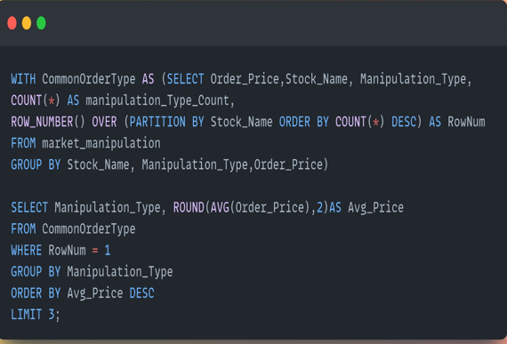

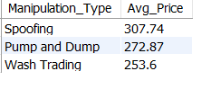
Determine the top 3 Most Common market manipulation Type and Its Average Price for Each Stock.

Slide 12
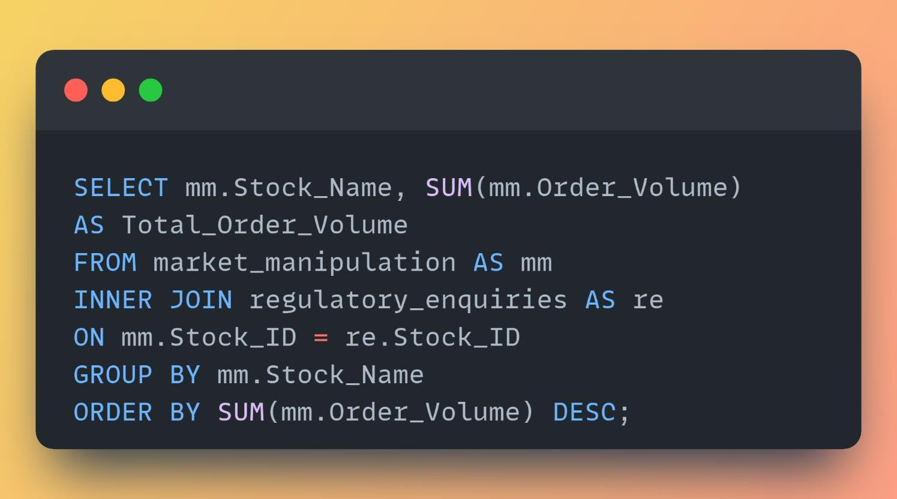

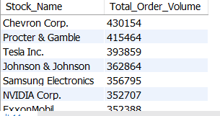
Business Question-6
Find the total volume of orders for each stock with a corresponding regulatory enquiry.

Slide 13
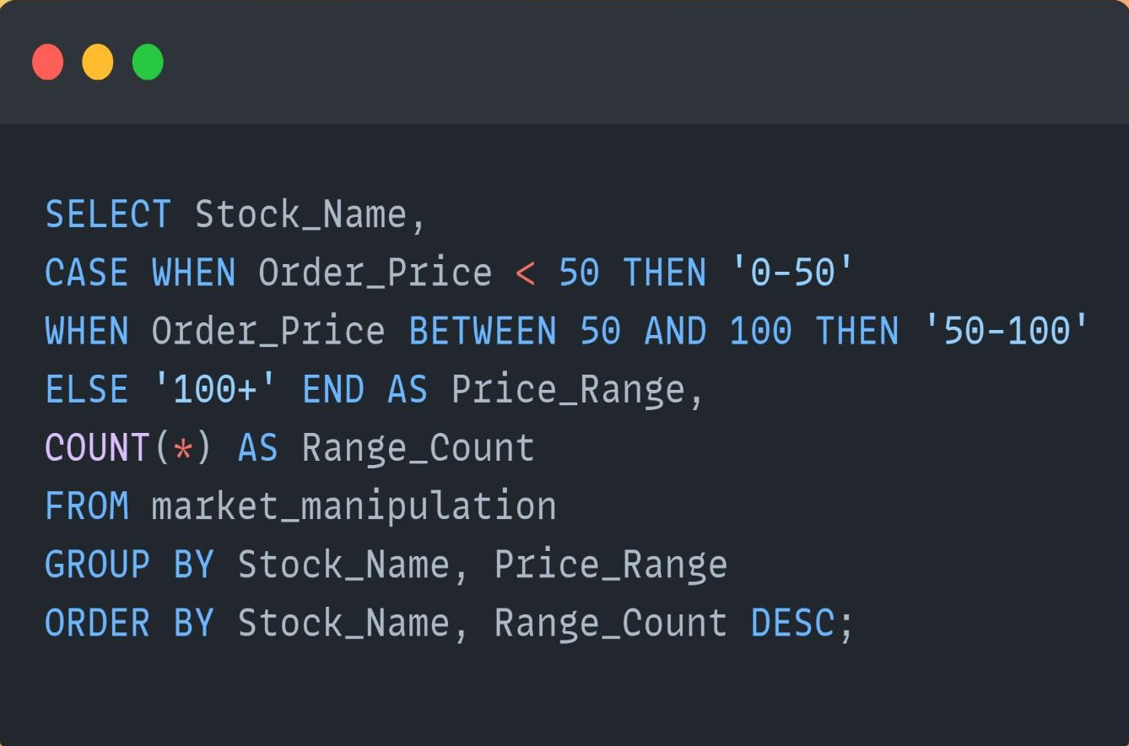

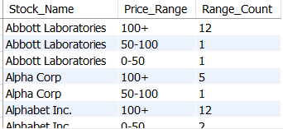
Business Question-8
Give a count of the different Price Ranges for Each Stock.

Slide 14
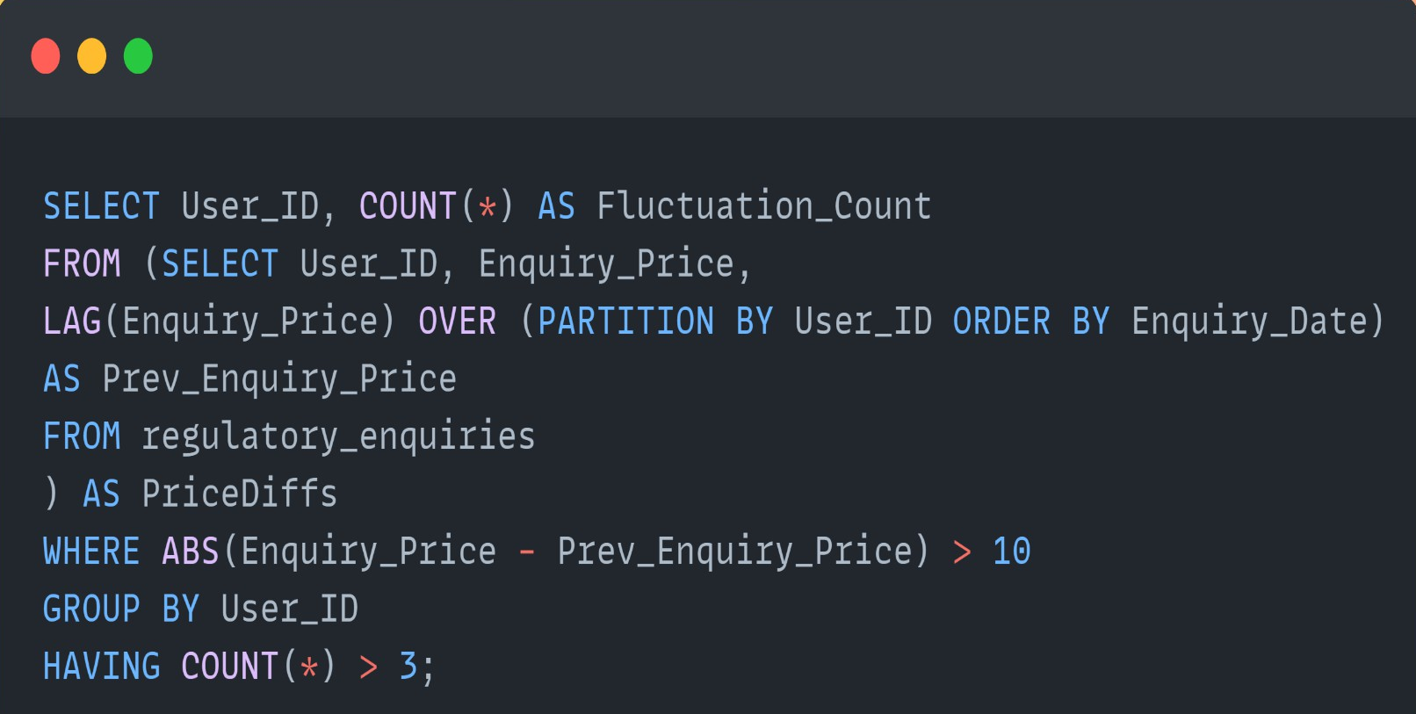

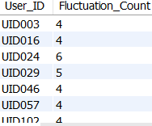
Business Question-9
Detect users who have experienced more than three significant fluctuations in enquiry prices. A significant fluctuation is defined as a change in price that exceeds 10 units compared to the previous enquiry price.

Slide 15
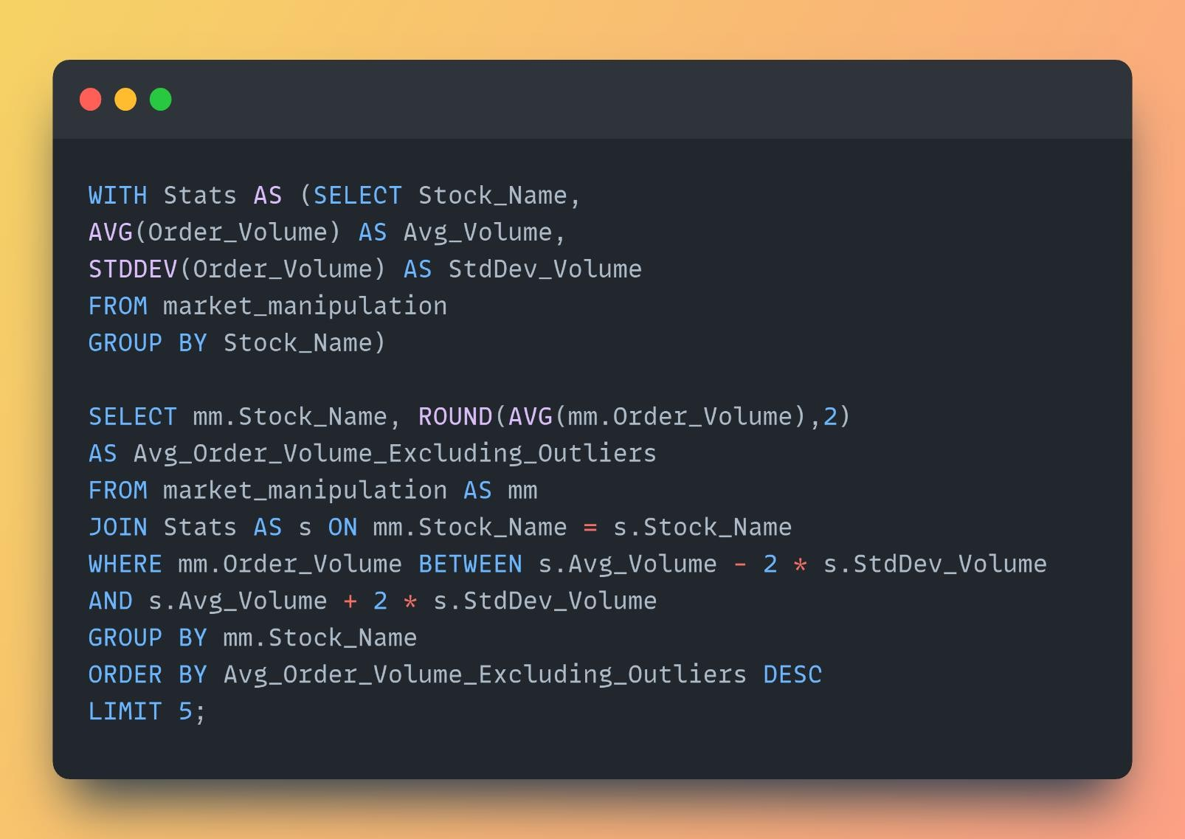

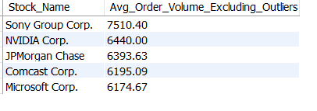
Business Question-10
Write a query to find the top 5 entities with the highest average order volume, excluding any extreme values. Calculate the average order volume for each entity, rounding the result to two decimal places.

Slide 16
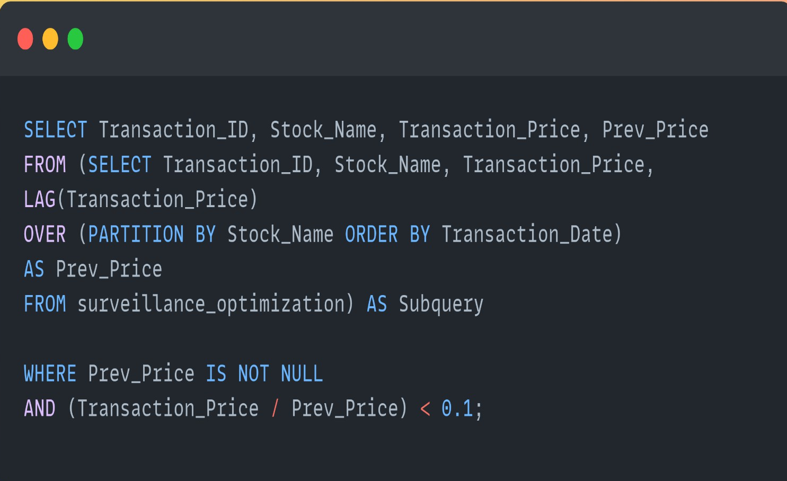

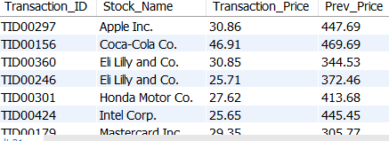
Business Question-12
Find Stocks with a Price Drop of More Than 90% Compared to the Previous Transaction.

Slide 17
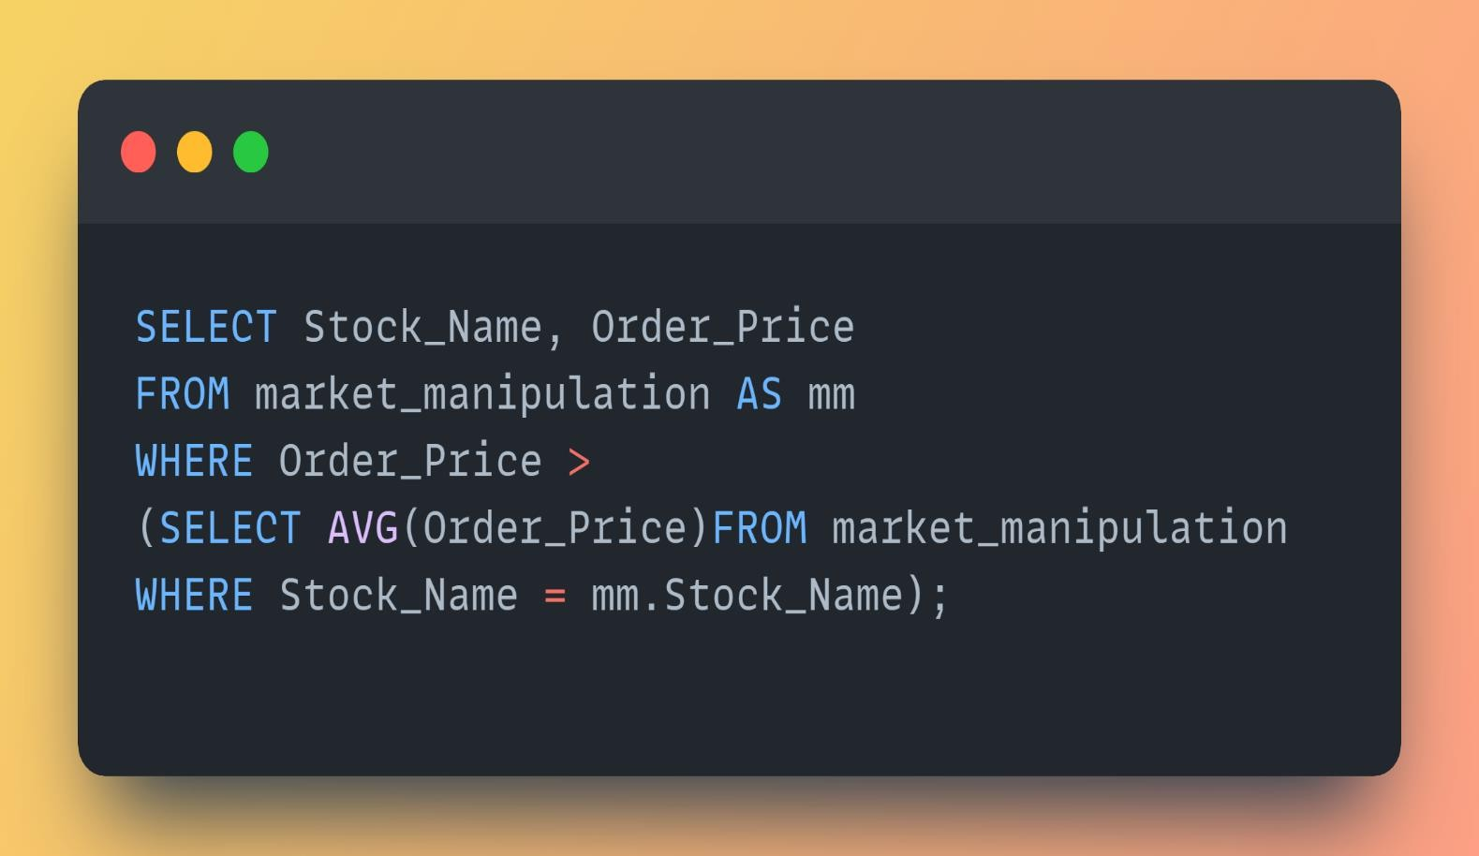

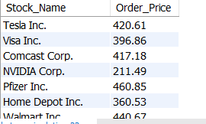
Business Question-13
Retrieve Orders with Manipulated Prices Higher Than the Average Manipulated Price for Each Stock.

Slide 18
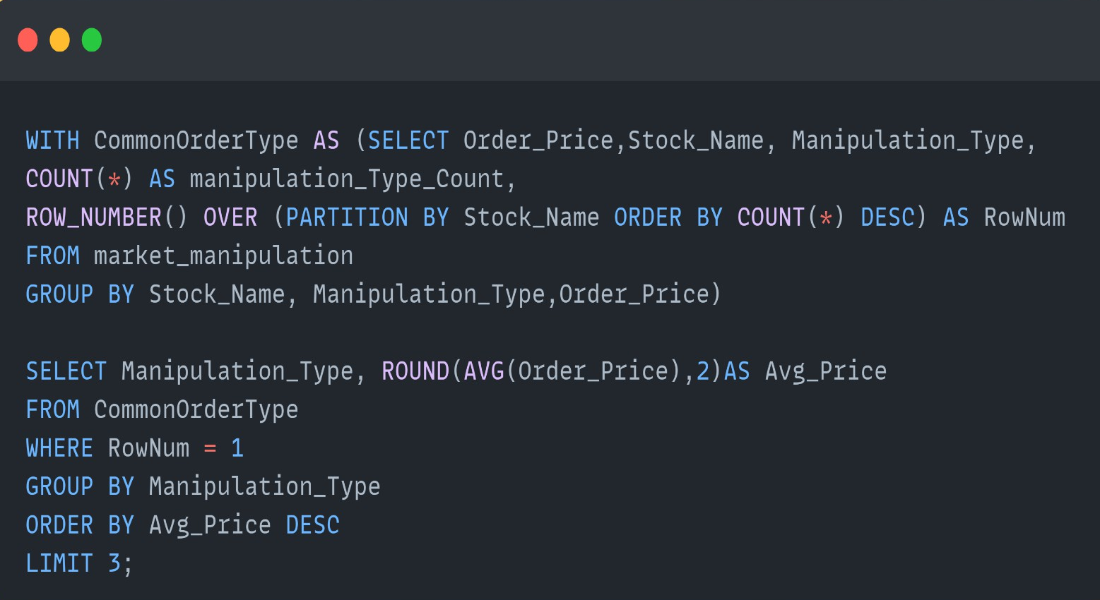
Busiess Question-15
Determine the top 3 Most Common market manipulation Type and Its Average Price for Each Stock.

Slide 19
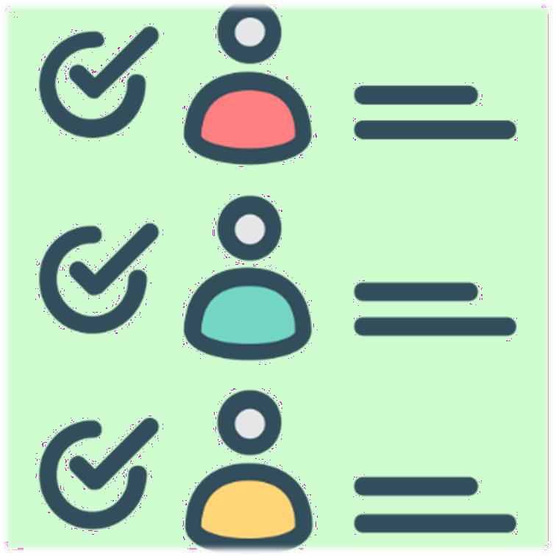

Key Findings-Transaction & Price
Out of all the surveillance data, SID072 has the greatest overall transaction value.
Chevron Corp. had the largest order volume (430,154), with Tesla Inc. (393,859) and Procter & Gamble (415,464) following.
The greatest price range (100+) has the majority of transactions.
The top 5 stocks by transaction percentage are PepsiCo Inc. (4.67%), Abbott Laboratories (4.67%), Alpha Corp (4.00%), Gamma Inc. (3.78%), and Johnson & Johnson (3.56%).
With a positive price difference of $409.54, JPMorgan Chase displayed the largest positive differential, followed by Toyota Motor Corp. ($207.87) and Walmart Inc. ($400.75).
Microsoft Corp.topped the growth chart in 2021 with a 1948.25% rise.
There were fifteen transactions involving different equities that saw price declines exceeding 90%.
At 301.91%, JPMorgan Chase experienced the largest post-manipulation price increase.

Slide 20
Key Findings-Manipulation & User Analysis
Top 3 Manipulated Stocks by Avg. Order Price: JPMorgan Chase ($343.32), Berkshire Hathaway ($334.69), Sony Group Corp. ($327.5).
Common Manipulation Types: Spoofing ($307.74), Pump and Dump ($272.87), Wash Trading ($253.60).
Highest Insider Trading Manipulated Prices: Delta Co. ($364.53), Epsilon LLC ($203.91), Gamma Inc. ($191.99).
Significant deviations from global trading patterns suggest suspicious activity.
Common enquiry types: Fraudulent Reporting, Front Running, Market Manipulation, Insider Trading.
16 users made multiple regulatory enquiries; 25 users had high regulatory volume transactions and
enquiries.
13 users had 4 to 6 significant price fluctuations in enquiry prices.
Users like UID004, UID011, UID021, UID029 showed notable price fluctuations in both transaction and enquiry prices.
Top Gains from Cross-Market Manipulation: UnitedHealth Group ($1.49M), Pfizer Inc. ($1.37M), JPMorgan Chase ($1.26M); Top Losses: Abbott Laboratories (-$316K), Visa Inc. (-
$276K).

Slide 21


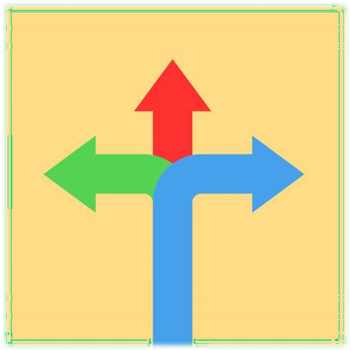
Conclusions
Stock Dominance: Stock ID SID072 and large-cap companies such as Chevron Corp. dominate the market in terms of trading volume, indicating market concentration.
Price Sensitivity: Large price movements in the stock prices of companies such as JPMorgan Chase and Microsoft indicate that these stocks are highly sensitive to market forces and manipulation.
Pervasive Manipulation: The high average order prices of manipulated stocks and common manipulative tactics such as spoofing, pumping and dumping, and wash trading indicate that market manipulation is widespread.
User Involvement: A significant number of users have been involved in regulatory investigations, highlighting the need for stricter market oversight.
Multiple Market Vulnerabilities: The potential for large gains and losses in multiple stocks indicates that manipulation in multiple markets poses significant risks to market stability.
Significant Fluctuations: The existence of price volatility among some users suggests that some users may be engaging in activities that could disrupt the market or profit from price fluctuations.

Slide 22
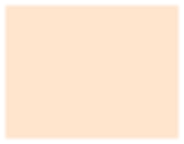

Recommendations
Enhanced Monitoring: A Strong Focus on stocks with high transaction values and price volatility for potential manipulation.
Targeted Audits: It is required to Prioritize investigation into Spoofing, Pump and Dump, and Wash Trading activities.
User Activity Review: Close monitoring users with multiple regulatory enquiries and significant price fluctuations.
Risk Mitigation: An Implementation of stronger controls to mitigate risks from cross-market manipulation, especially for high-impact stocks.
Proactive Reporting: Strengthen fraud detection mechanisms for common enquiry types like Fraudulent Reporting and Insider Trading.

Slide 23

Future Work
Enhanced Data Collection: Incorporate real-time data feeds, social media sentiment, and news analysis to better detect manipulation patterns.
Advanced Analytics: Implement machine learning models for anomaly detection and predictive insights to identify subtle manipulation strategies.
Real-time Monitoring: Develop tools for real-time detection of suspicious activities, allowing for immediate response to potential fraud.
Collaboration with Regulators: Partner with regulatory bodies to share insights and improve monitoring techniques for market compliance.
User Behavior Analysis: Profile trader behaviors to better predict and mitigate potential manipulation activities.
Blockchain for Transparency: Explore blockchain technology to enhance transparency and reduce manipulation opportunities.

Slide 24

THANK YOU

